Slide 1


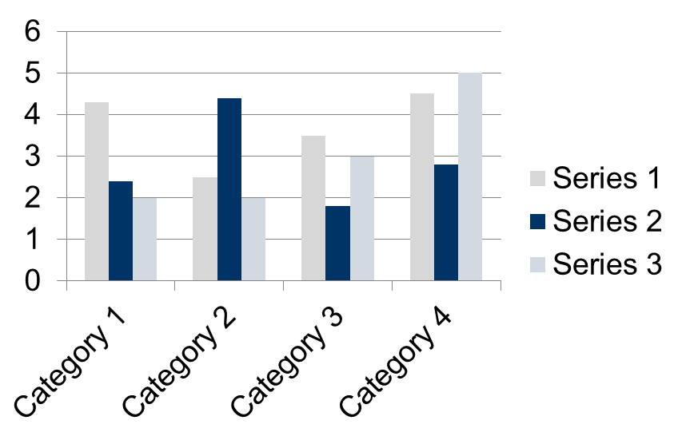
Abstract
Results
This template was designed to produce a 1189mm x 841mm (A0 size) poster in portrait orientation.
Making use of this template will ensure that your poster will look professional, easy to read and save you valuable time in the layout of your presentation.
Image resolutions 300 dpi
Fonts, Calibri – At least size 28
Final document, in pptx or pdf file
Importing tables, charts and graphs is easier than importing photos. To import charts and graphs from Excel, Word or other applications, select EDIT>COPY, to copy your chart and then come back to PowerPoint. From PowerPoint, select EDIT>PASTE and paste the chart on the poster. You can scale your charts and tables proportionally by holding down the Shift key and dragging in or out one of the corners.
TABLE SAMPLE
1998 | 1999 | 2000
2001 | 2002 | 2003
2004 | 2005 | 2006
Introduction
To start using this template you first need to delete most of the contents of this page. Keep the poster title and one of the blue section headers.
After you decide how many sections you need for your poster (Introduction, Methods, Results, References, etc.), use the “copy” and “paste” commands to create as many copies of the blue section headers as needed.
You can now start adding your text.
Repeat the process throughout the poster as needed.
Conclusion
A conclusion might go here.
Methodology
Acknowledgments
For this poster template the Arial font family is used at several recommended text sizes. You can use any typeface you like and at any size but try to stay close to the suggested limits.
Acknowledgements here.
Contact Information
Corresponding author’s Name
Address | Tel: +1 066 - 666666 Fax: +1 066 - 777777 Email: author@address.org Web: www.yourwebsite.org

